Slide 1
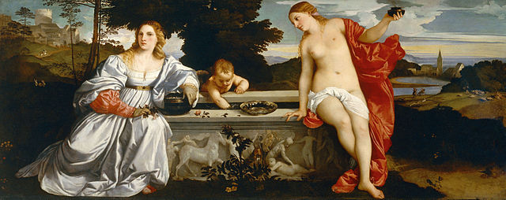
History 336
Ideas and Society in Early Modern Europe:
The Debate about Gender and Identity

Slide 2
Office Hours for Week of 17 February
Monday, 18 February: 1 to 3 pm
office hour cancelled on Wednesday, 11:30-12:30
Regular office hours will resume the week of 24 February.

Slide 3
What is history?
Albert S. Lindemann, Esau’s Tears: Modern Anti-Semitism and the Rise of the Jews (Cambridge: Cambridge University Press, 1997), 16: “History lets us see what men and women have been, lets us understand how much more remarkable they have been than our untutored imaginations could possibly realize.”

Slide 4
Writing to / about wives
Carnival? (p. 142)
shaming strategy: pagans vs. Christians (pp. 136, 140, 152, 184, 185, 192)
rhetoric of reproach (pp. 151, 240, 251)
purpose of marriage (p. 175)
virtues of a wife (p. 176, 177, 180, 218, 223, 231, 242)
ancient examples and wisdom (p. 197, 208-209, 215, 233, 245, 246-47)
Bible (pp. 195, 198)
Church Fathers (pp. 236-39, 241)

Slide 5
Questions for 18 February
What passages from the reading assigned for today strike you as historically significant?
What continuities exist between what you have read about wives in The Education of a Christian Woman and (1) what you have read about virgins and (2) what you have learned so far about women and gender in early modern Europe?
Did you notice any discontinuities?

Slide 6
Questions for 18 February
Vives writes that there should “be a certain equality, or better, similarity between husband and wife that unites their souls and hold them together more tenaciously than anything else” (p. 158). Did you notice an equality or similarity between husband and wife in his section on wives?
What is the ideal wife according to Vives? What should a wife not be like?
Can you formulate at least one historical question based on the assigned reading to start a larger discussion?

Slide 7
Questions to consider for the rest of the course
What passages strike you as historically significant? Mark them and write them down.
What positions on women and gender does a given primary source take on women and gender? How does the author support these positions?
Can you formulate at least one historical question based on the assigned reading to start a larger discussion?
Can you find a few secondary sources (and other primary sources) by using the library catalogue and databases that will help you answer your historical question?
Can you think of any current news stories that relate to women and gender?

Slide 8
In the news
“Women across the world stage protests against violence,” BBC, 14 February 2013 http://www.bbc.co.uk/news/world-asia-21460056

Slide 9
Essay help
Answer the question directly to give your essay a solid analytical focus.
Explain important points with reference to concrete historical reality.
Use your sources properly.
Provide specific footnote references for specific information that you could not have known without reading your source.
Quote accurately.
Accurately represent the information and interpretations in your source.

Slide 10
Essay help
proper footnote and bibliographic format
Follow the examples of the prescribed format available on the course home page.
active voice vs. passive voice
The active voice provides agency and clarity.
Active (clear)
Journeymen excluded women from craft guilds to prevent cheapening the value of labour in the urban economy.
Passive (opaque)
Women were thought to cheapen the value of labour in the urban economy.

